Slide 1
Communication
In personal effectiveness and teamwork

Slide 2
Table of contents
01
02
03
04
05
Conflict
Model
Active
Listening
Dismantling
Hierarchies
Using proper language
Value of
Feedback

Slide 3
Conflict Model
01
How to navigate conflict in a team

Slide 4
Why is this important?
Helps to understand the nature of conflict
Improves problem-solving
Enhances communication skills

Slide 5
3 stages of conflict
Self
The problem
Others
If there is no threat to perceived self worth, there's no conflict

Slide 6
Brief History of Thomas-Kilmann Conflict Model
In the early 1970s, Kenneth W. Thomas and Ralph H. Kilmann initially developed as a research tool
The model is based on theoretical refinements of a model of management styles proposed by Robert Blake and Jane Mouton in the 1960s
Select Reference:
Kenneth, T., & Ralph, K. (1974). Thomas Kilmann Conflict Model

Slide 7
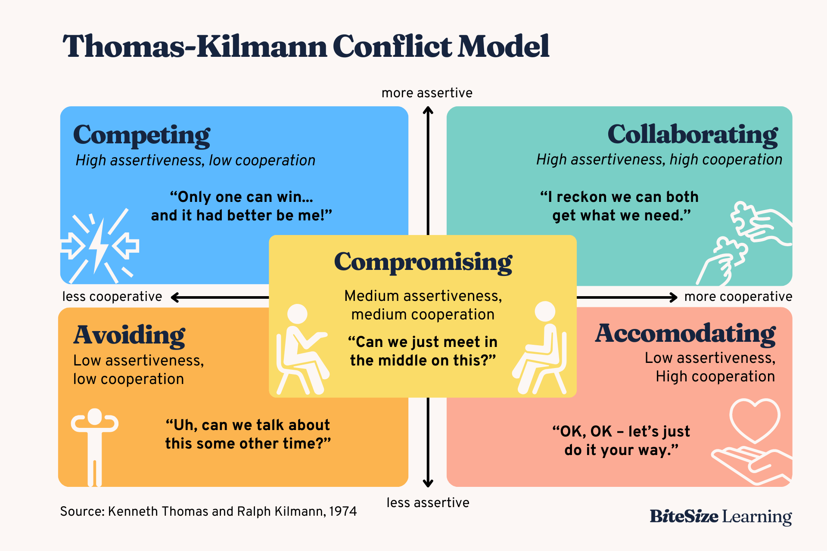

Slide 8
Examples
Avoiding
Compromising
Collaborating
The issue is super minor or low priority
If an agreement on one idea cannot be decided, the parties involved might decide to take some parts from each idea to compromise
If a person introduces a new idea that affects multiple stakeholders, that employee will collaborate with the stakeholders to evaluate the effects of the changes

Slide 9
Which mode do I use?
No catch-all situation!
Personality traits of everyone involved
The problem itself
Interpersonal relationships
Hierarchical position

Slide 10
How am I achieving certain goals with my mode of conflict?

Slide 11
pre-discussion
Key Topics
Active Listening: Evolved from therapy & psychology to various domains (e.g., parenting, business).
Dismantling Hierarchies: Transitioning from rigid top-down structures to more collaborative models.
Why It Matters
Fosters better team cohesion.
Encourages creativity and innovation.
Increases employee engagement and satisfaction.
Notes:
% "I'll be exploring two major facets of modern workplace communication: active listening and dismantling hierarchies.
% Active listening has its roots in psychology and counseling, and it has since become an essential skill in parenting, corporate communications, and beyond.
% Meanwhile, dismantling traditional hierarchies is about ensuring that everyone’s voice is heard, not just those at the top.
% We'll see why both are critical to fostering a more inclusive, innovative, and productive work environment."
Original: https://www.overleaf.com/project/67b4c688b13c79ef5983da21

Slide 12
02
Active Listening

Slide 13
Short History (Active Listening)
Origins of Active Listening
Coined and popularized by psychologists like Carl Rogers in the 1950s.
Spread to education and corporate sectors in the 1970s and 1980s.
Modern Use
Now seen as a critical skill in management training and team-building.
Emphasizes empathy, clarification, and providing a safe space to
speak.
Notes:
% Speaker notes:
% "Active Listening, as a formal term, is often traced back to Carl Rogers in the 1950s.
% Rogers believed that empathetic understanding was crucial in therapeutic settings.
% Over time, this skill was found to be just as important in schools and businesses, helping to improve dialogue and mutual understanding."

Slide 14
Active Listening – Core Principles
Giving Them Space: Allow the speaker to finish without interruption.
Showing Interest: Use verbal and nonverbal cues (e.g., nodding, eye contact).
Clarifying & Reflecting: Paraphrase to ensure understanding.
Avoiding Judgement: Listen to understand, not to immediately offer solutions or criticisms.
Why It Works
Builds trust and rapport.
Encourages open dialogue and better problem-solving
Notes:
% Speaker notes:
% "Active listening is more than just hearing words. It’s about giving the speaker room to share, showing genuine interest through your body language, clarifying any confusing points, and reflecting back to ensure you understood them correctly.
% One of the biggest pitfalls is rushing to judge or offer advice before fully hearing the other person.
% When done well, active listening fosters a sense of trust and encourages team members to share openly."

Slide 15
03
Dismantling Hierarchies

Slide 16
Short History
Traditional Workplace Structure
Heavily influenced by Frederick Taylor’s Scientific Management
(early 1900s).
Clear top-down approach with power concentrated at the top.
Modern Shift
Post-1980s: Team-based and flat structures emerge.
Tech startups popularized collaborative and horizontal leadership.
Notes:
% Speaker notes:
% "The classic workplace structure was shaped by Frederick Taylor’s Scientific Management, emphasizing efficiency with a clear chain of command.
% However, from the 1980s onward, there’s been a shift towards flatter structures and collaborative leadership—particularly driven by tech startups.
% This shift is about giving everyone a seat at the table."

Slide 17
Practical Steps
Strategies for a More Collaborative Workplace
Open-Door Policy: Encourage regular, informal check-ins.
Rotating Leadership Roles: Different team members lead projects.
Transparent Decision-Making: Share rationales behind major decisions.
Flattening Power Dynamics: Encourage input from all levels.
Data Points
Companies that emphasize employee voice see a 4.6x higher level of performance (HBR, 2018).
Gallup finds highly engaged teams show 21% greater profitability (Gallup, 2017).
Notes:
% Speaker notes:
% "Dismantling hierarchies doesn’t mean having no structure at all; it means ensuring that every individual’s voice counts.
% One way is by rotating leadership responsibilities so no single person always has the power.
% Open-door policies and transparent decision-making also signal that the organization values open communication.
% According to a Harvard Business Review study, companies with strong employee voice are far more likely to outperform their competitors, and Gallup research shows that engaged teams are significantly more profitable."

Slide 18
Conclusion & Citations
Key Takeaways
Active Listening: A cornerstone of effective communication; fosters trust and clarity.
Dismantling Hierarchies: A modern, inclusive approach that boosts innovation and performance.
Action: Implement these strategies to enhance workplace culture and outcomes.’
Select References:
Carl Rogers (1951). Client-Centered Therapy.
Harvard Business Review (2018). Employee Voice and Organizational Performance.
Gallup (2017). State of the American Workplace.
Frederick Taylor (1911). The Principles of Scientific Management.
Notes:
% Speaker notes:
% "In conclusion, active listening and dismantling hierarchies are two critical components of modern workplace communication.
% By practicing active listening, we show respect and empathy, improving both team morale and problem-solving.
% By moving away from rigid top-down models, we create an environment where new ideas can flourish and everyone feels valued.
% Here are some references if you’d like to explore further."

Slide 19
04
Using Proper Language

Slide 20
The Values Proper Language
Precision and Clarity in Communication – Using proper language ensures that ideas can be explained with accuracy.
Encourages Learning – Correct language will encourage listeners to feel more thought provoked when listening.
Understanding – Using the right language doesn't just help with communication, it also helps with understanding.

Slide 21
The Cognitive Side: How it helps you
Deepens Understanding Through Explanation – Articulating ideas aloud transforms abstract thoughts into structured language.
Clarifies Complex Thoughts – Expressing thoughts verbally compels the brain to organize them logically.
Enhances Memory Retention – Reading information aloud engages both speaking and hearing parts of your brain.
Notes:
Deepens Understanding Through Explanation – Articulating ideas aloud transforms abstract thoughts into structured language, enhancing comprehension. This process, often referred to as the "protégé effect," suggests that teaching or explaining concepts to others reinforces one's own understanding.
Clarifies Complex Thoughts – Expressing thoughts verbally compels the brain to organize them logically, facilitating deeper reasoning and problem-solving. This method, known as "thinking aloud," has been shown to aid learning and cognitive processing.
Enhances Memory Retention – Reading information aloud engages both speaking and hearing faculties, creating distinct memory traces that improve recall. Research indicates that this dual action significantly benefits memory retention.

Slide 22
Conclusion & Citations
Key Takeaways
Proper Language Strengthens Communication: Clear and precise language reduces misinterpretation and enhances understanding.
Verbal Expression Enhances Thought Clarity: Speaking ideas aloud allows for deeper reasoning, problem-solving, and memory retention.
Effective Communication Fosters Learning: When ideas are explained well, they become easier to grasp, reinforcing knowledge for both the speaker and the listener.
Select References
The Guardian (2024). The Protégé Effect: How Teaching Helps You Learn.
PubMed Central (2018). Thinking Aloud as a Cognitive Learning Strategy.
University of Waterloo (2017). The Benefits of Reading Aloud for Memory Retention.
Notes:
In conclusion, proper language, verbal expression, and effective communication are essential for both personal and professional growth. Clear language reduces misunderstandings and helps us explain ideas more precisely. Speaking aloud allows us to process and refine our thoughts, which aids problem-solving and memory retention. Lastly, explaining ideas not only reinforces our own understanding but also makes learning easier for others.

Slide 23
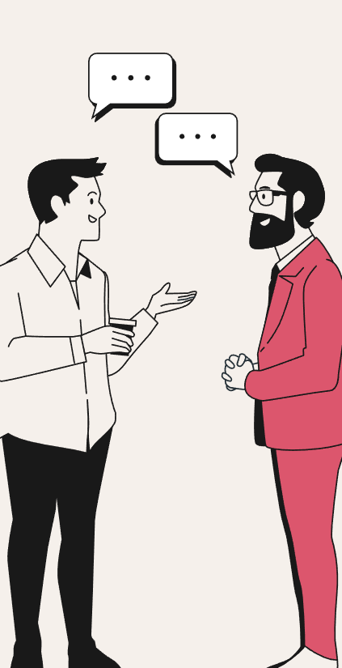
05
Value of feedback

Slide 24
The Value of feedback
Encourages Growth and Improvement – Constructive feedback helps people see where they can improve but also see what areas they are strong in.
Effective Delivery Enhances Impact – For feedback to be constructive, it must be clear, specific, and delivered in a way that the recipient can understand and apply.
Reinforces Understanding – Feedback is crucial for good communication and growth, as it helps individuals recognize gaps in their knowledge and refine their thinking.
Notes:
Encourages Growth and Improvement – Constructive feedback helps people see where they can improve but also see what areas they are strong in. It provides clear guidance on how to refine skills and improve.
Effective Delivery Enhances Impact – For feedback to be constructive, it must be clear, specific, and delivered in a way that the recipient can understand and apply. Poorly communicated feedback can cause confusion or discouragement.
Reinforces Understanding – Feedback is crucial for good communication and growth, as it helps individuals recognize gaps in their knowledge and refine their thinking. When feedback is specific and well-delivered, it allows for deeper reflection and ensures continuous improvement in both learning and performance.

Slide 25
Impact of Critical Feedback
Case Study: Impact of Critical Feedback in Education – (Hattie, J., & Timperley, H. (2007). The Power of Feedback. Review of Educational Research.)
Application to the Workplace – In the work world, the same principles apply.
Notes:
Case Study: Impact of Critical Feedback in Education – A study conducted by Hattie and Timperley on feedback in educational settings demonstrated that students who received specific, critical feedback performed significantly better than those who only received general praise. The feedback helped learners not only identify errors but also understand the steps needed to improve, resulting in a measurable increase in achievement. (Hattie, J., & Timperley, H. (2007). The Power of Feedback. Review of Educational Research.)
Application to the Workplace – In the work world, the same principles apply: employees who receive good, critical feedback are more likely to improve performance and develop the necessary skills for career advancement.
Select References
Hattie, J., & Timperley, H. (2007). The Power of Feedback. Review of Educational Research.

Slide 26
Conclusion & Citations
Key Takeaways
Feedback Drives Growth: Constructive feedback helps individuals identify areas of strength and weakness.
Clear Delivery Maximizes Impact: Effective feedback must be specific and easy to understand.
Continuous Improvement Through Reflection: Feedback fosters deeper understanding by pinpointing gaps in knowledge.
Select References
Hattie, J., & Timperley, H. (2007). The Power of Feedback. Review of Educational Research.
Notes:
In conclusion, feedback is a powerful tool for growth and improvement. Constructive feedback helps individuals recognize both their strengths and areas for development, offering the clarity needed to refine their skills. However, feedback must be delivered clearly and specifically to have the desired impact—this ensures it leads to progress rather than confusion. Finally, feedback encourages continuous improvement by helping individuals reflect on their performance, identify knowledge gaps, and take actionable steps to grow.

Slide 27
Thank you!
Do you have any questions or feedback?
If not,
What strategy/topic do you plan to apply to your professional development?
Please keep this slide for attribution

